Slide 1
SPA. React
Nataliia Svystun

Slide 2
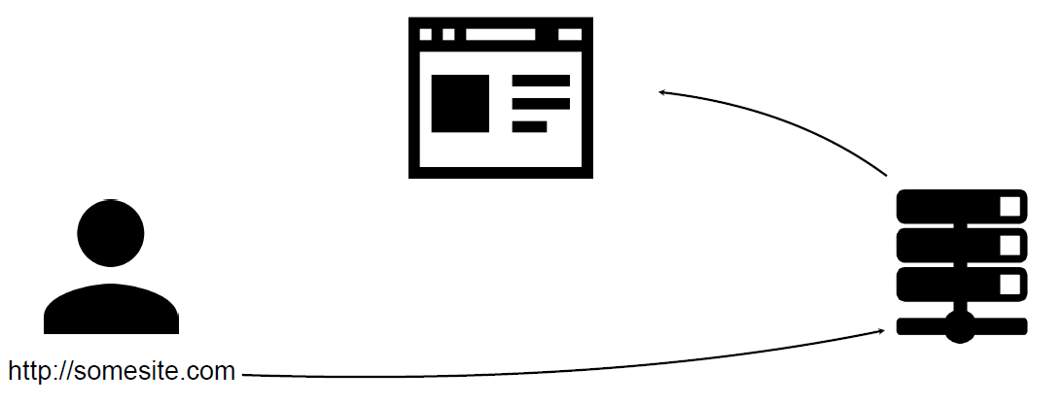
A Regular Website

Slide 3
A Regular Website

Slide 4
A Regular Website

Slide 5
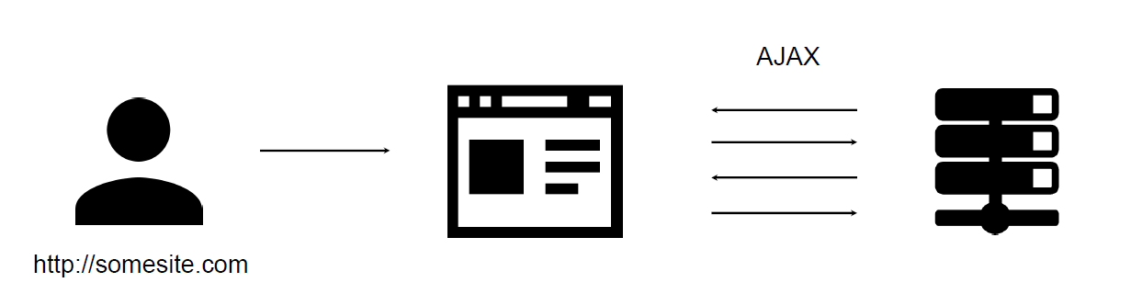
Single-page Application (or SPA)
The most notable difference between a regular website and an SPA is the reduced amount of page refreshes.
SPAs have a heavier usage of AJAX — a way to communicate with back-end servers without doing a full page refresh — to get data loaded into our application.
As a result, the process of rendering pages happens mostly on the client-side.

Slide 6


Popular JavaScript Frameworks for Building SPAs
There are a lot of open source JavaScript frameworks that help with building SPAs, such as:

Slide 7


React – what is it?
React is not considered a framework, per se — rather, it touts itself as a view library.
React allows developers to create large web-applications that use data and can change over time without reloading the page.
It aims primarily to provide speed, simplicity, and scalability.
React processes only user interfaces in applications.
This corresponds to View in the Model-View-Controller (MVC) pattern, and can be used in combination with other JavaScript libraries or frameworks in MVC, such as AngularJS.
This corresponds to View in the Model-View-Controller (MVC) pattern, and can be used in combination with other JavaScript libraries or frameworks in MVC, such as AngularJS.

Slide 8
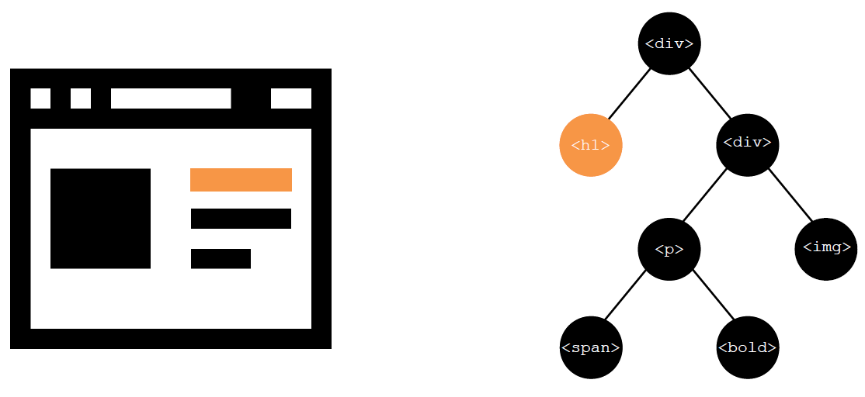
Document Object Model (or DOM) -
Page
Document Object Model (or DOM)

Slide 9
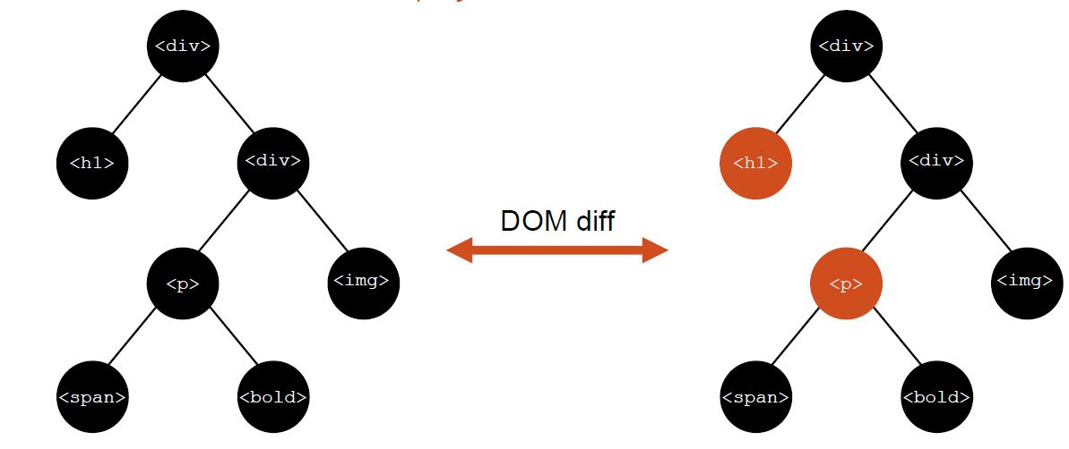
Virtual DOM
Notable feature is the use of a "virtual DOM". React creates an in-memory data structure cache, computes the resulting differences, and then updates the browser's displayed DOM efficiently. This allows the programmer to write code as if the entire page is rendered on each change, while the React libraries only render sub components that actually change.

Slide 10
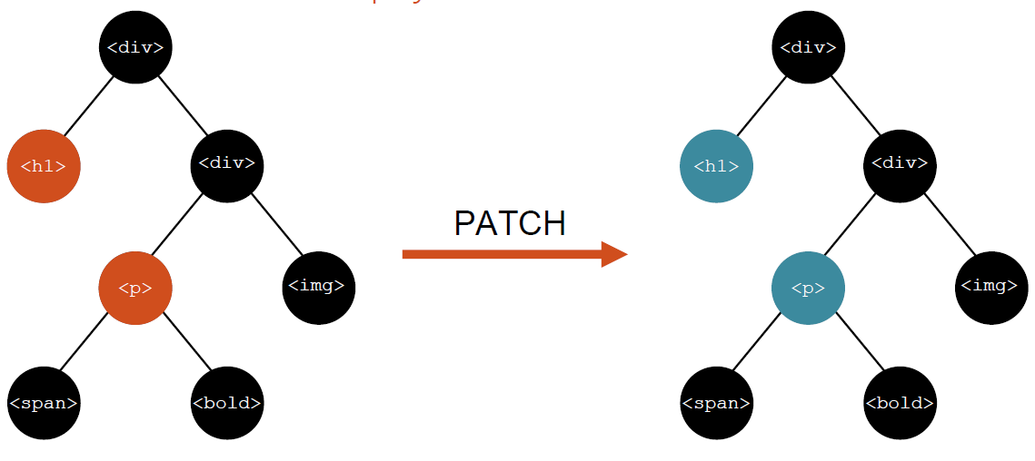
Virtual DOM

Slide 11
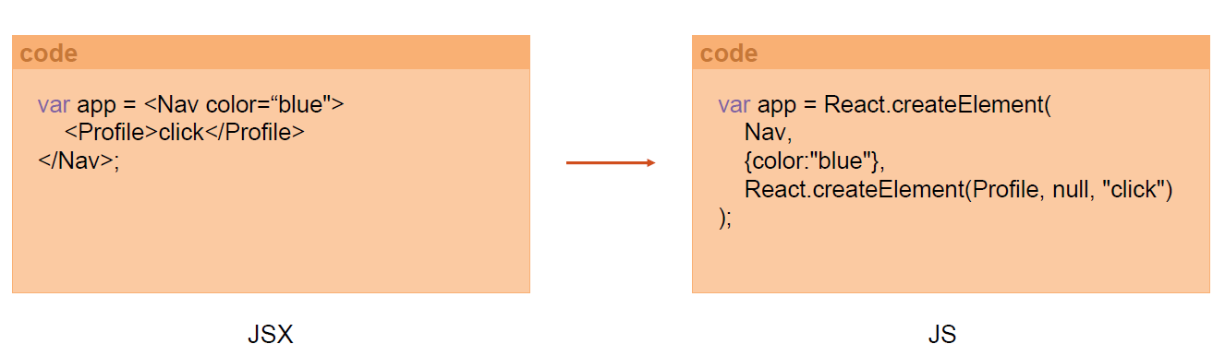
JSX
React components are typically written in JSX, a JavaScript extension syntax allowing quoting of HTML and using HTML tag syntax to render subcomponents. HTML syntax is processed into JavaScript calls of the React framework.
Developers may also write in pure JavaScript. JSX is similar to another extension syntax created by Facebook for PHP, XHP. JSX looks like regular HTML.

Slide 12
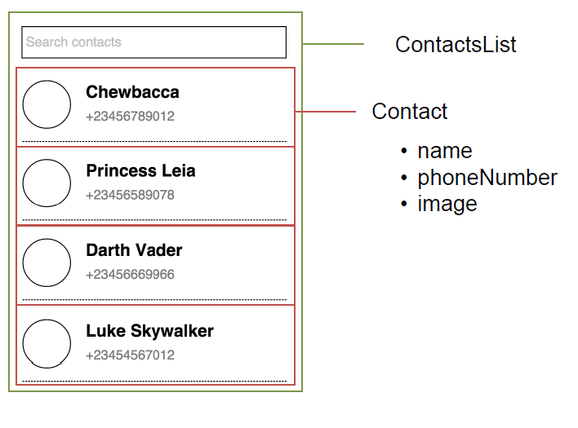
Components
Components are the heart and soul of React.
var HelloWorld = React.createClass({
render: function() {
return (
<h1> Hello world! </h1>
);
}
});

Slide 13
Example
<!DOCTYPE html>
<html lang="en">
<head>
<meta charset="UTF-8">
<title>Hello World!</title>
<script src="https://cdnjs.cloudflare.com/ajax/libs/react/0.16.0/react.js"></script>
<script src="https://cdnjs.cloudflare.com/ajax/libs/react/0.16.0/react-dom.js"></script>
<script src="https://cdnjs.cloudflare.com/ajax/libs/babel-core/6.1.19/browser.js"></script>
</head>
<body>
<div id='content'></div>
<script type="text/babel">
var HelloWorld = React.createClass({
render: function() {
return (
<h1> Hello world! </h1>
);
}
});
ReactDOM.render(
<HelloWorld />,
document.getElementById('content')
);
</script>
</body>
</html>

Slide 14

Questions

